Slide 1

Exploratory Data Analysis on Car Sales
by Rohit Chouhan

Slide 2
Exploratory Data Analysis on Car Sales
by Prathiba Chouhan

Slide 3
Introduction
Here, I will be discussing about Data on Car sales of 56 years ranging from 1959 to 2016.
Columns and its meaning is as follow
car --> Brand Name of car
price --> Sell price of a car.
body --> Type of the material of which car made up of
mileage --> Number of miles car has travelled
engV --> Range of engine
engType --> Type of engine in car
year --> Manufacture year of car
model --> Model Name of car
drive--> Car's driven wheel type
registration--> Car is registered or not

Slide 4
Handling Missing values
Price : Replaced nan value with its median after grouping by model
Mileage : Assuming zero value as new car (0 miles travelled)
Drive : Replaced nan with its mode value after grouping by drive
Registration : Dropped this column.
Engine Value : Replaced nan value with Median after grouping by car

Slide 5
Key Data Points
Statistics are prepared considering below points
10 years of car sales data
Top 3 Car Sales Data
Model of a car
Body type of a car
Engine type of a car
Drive type of car
Price of a car

Slide 6
Problem statement
Out of top 3 car sold, BMW car sales is consistently low for the past 10 years. We are analyzing the data to determine how sales vary based on multiple factors of a car.

Slide 7
Investigation
Considered 10 year of sample data and identified top 3 car sold which are Mercedes-Benz, Volkswagen and BMW
Analysed Impact on sales based on below comparison
Correlation between year and price
Correlation between mileage and price
Engine type v/s Car body
Drive v/s Car body
Car Model v/s Engine type
Car Model v/s Drive type
Price range

Slide 8
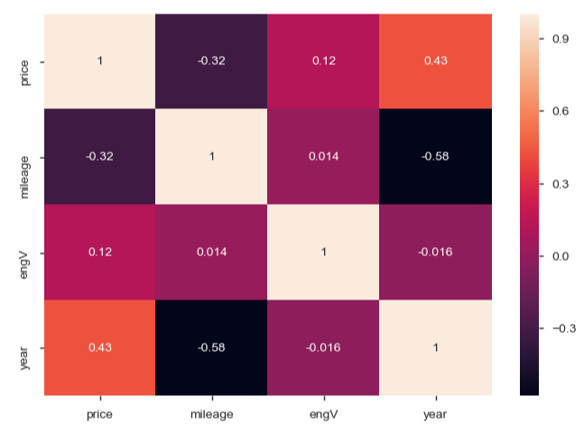
Correlation - Price vs Year & Mileage vs Year

Slide 9
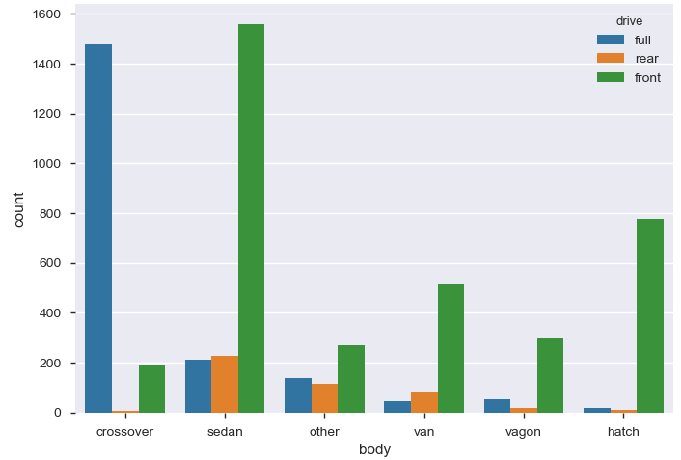
Drive vs Body type Count Plot graph

Slide 10
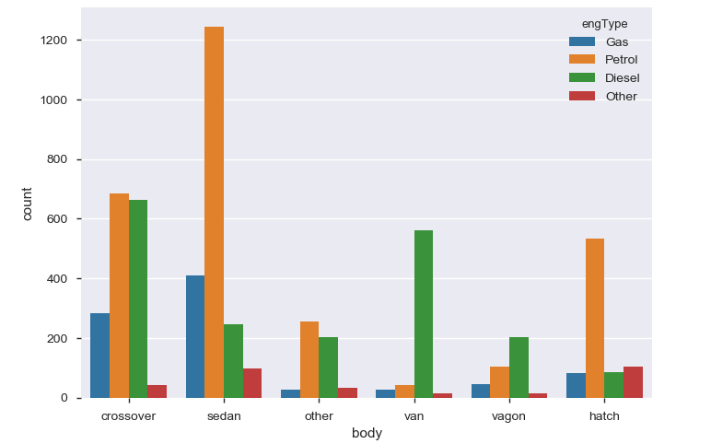
Body type vs Engine type count plot graph

Slide 11
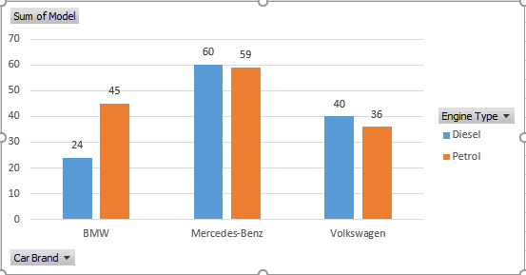

Engine type vs Car Model count

Slide 12
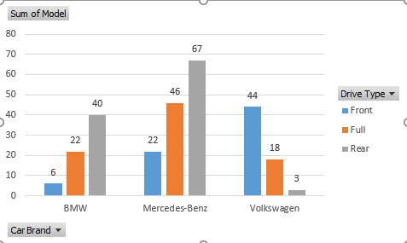

Drive type vs Car Model count

Slide 13
Conclusion
Car sale is increased from 2009 - 2012 and then decreased from 2012 - 2015.
Most sold body type is Sedan (38%) and Crossover (22.5%)
Share of Petrol Car is 46% and Diesel share is 32%
Share of Front Wheel Drive is 60% followed by Full Wheel Drive with 26%
Car with price less than 20K are sold most with a share of 69%
Petrol car share for price range less than 20K is 49%
Front Wheel Drive Car share for price range less than 20K is 79%
Sedan, Crossover and Hatch Body share for price range less than 20K is 70%
Most sellable car is Front Drive Sedan followed by Full Drive Crossover
Most sellable car is Volkswagen with sedan/crossover body with front drive.

Slide 14
Actionable Insight
BMW needs to manufacture model with below features to increase its sales.
Diesel Engine
Front Wheel Drive
Sedan/Crossover Body
.

